Slide 1
Claim Fraud Detection
Cherry.liu
2022.09

Slide 2
Background
Process & Results
Next Step
Notes:
My presentation contains 3 parts: background, process and results and next step.

Slide 3
1. Background
Fraud Risks
cost loss
reputation
damage
bad customer
experience
Claim Process：
fraud detection
report
register
survey
insurance
accounting
adjustment
payment
Notes:
Firstly, I’m gonna talk about the background.
For claim fraud risks, there are 3 main impacts, cost loss, reputation damage and bad customer experience. The most direct loss is cost loss, and reputation damage and customer experience are both irreversible losses. So it’s important to detect the fraud and flag the risks.
The whole claim process can be simply divided into 7 steps, report, register, survey, insurance, accounting, adjustment and payment. I won’t talk about the details, just to show u the scene we use the fraud detection model. As u can see, the model will be used after ‘insurance’.
Is there any questions ?
Am I making sense ?

Slide 4
Background
Process & Results
Next Step
Notes:
Next, I’d like to move to the second part: process and results.

Slide 5

2. Process & Results
Process
Data
Data deal
time of report
time of accident
time interval between report and accident
compensation amount
time interval between insurance and accident
damage type
purchase price of new car
multiple vehicle damaged flag
……
LightGBM
+
Isolation
Forest
V
1
date of report
date of accident
compensation amount
start date of policy
damage type
brand of vehicle
purchase price of new car
……
Data analysis
Data aggregation
Predict fraud probability
Feature engineering
Comparison of model results (New model launched on 2021-11)：
 | refuse | total | accuracy
tongdun (top 2%) | 104 | 1871 | 5.6%
liberty (top 2%) | 51 | 1783 | 2.9%
 | refuse | total | accuracy
tongdun (top 2%) | 23 | 461 | 5.0%
liberty (top 2%) | 28 | 466 | 6.0%
Old model
New model（2021-11~2022-03）
Notes:
As u can see, the whole process mainly consists of three major components: data, feature and model. At first, we extracted basic data about the claim from database, such as ‘date of report‘, ’date of accident’，‘compensation amount’ and so on. And then, we did data deal and data analysis, including data clean, outliers deal and data distribution check and so on. And then, we did data aggregation to generate some new features, such as the time interval between report and accident. And feature engineering to encoding some features. And last, we put these features to train models. We trained 2 models, lightGBM and IsolationForest respectively. We trained lightGBM at first, and use IsolationForest to train the data that lightGBM can’t predict well. After these process, we can get a score, which between 0 and 1, the higher the score is, the higher the probability of fraud.
So is there any questions about this pipeline.
The two tables are the comparison results of old model, new model and the tongdun’s model. Just a mention, tongdun is our cooperative company, they built a model for us before we built this new model. As u can see, (we only choose the top 2 percent results, this value was given by business person.) tongdun’s model is better than our old model, and our new model is better than tongdun’s model.
Is there any questions?

Slide 6
Background
Process & Results
Next Step
Notes:
Next, I’d like to move to the last part: Next step.

Slide 7
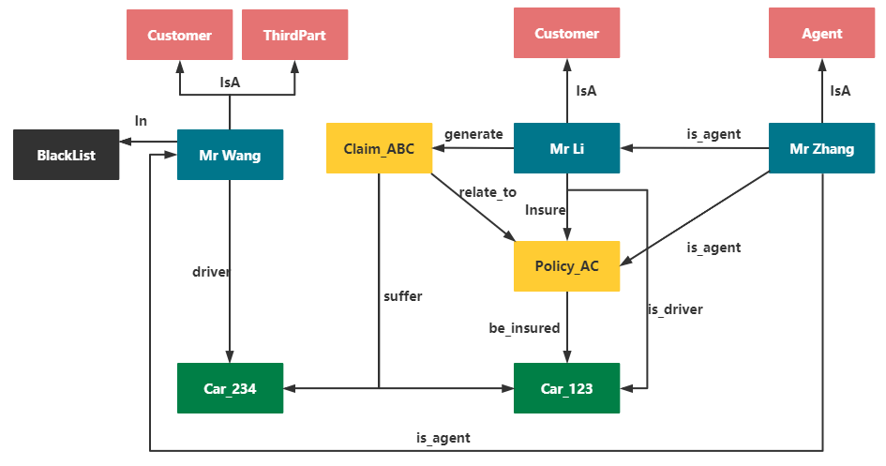
3. Next Step
Leverage Knowledge Graph to mine deep relationships and get fraud cases to increase the explainability and flag the risk earlier.
Framework
mining deep relationships
Build KG
Discover Fraud
V2
policy holder
third part
surveyor
……
Person
used-year
brand
……
Vehicle
repair shop
hospital
……
Organization
black list
……
Others
Notes:
At first, we are gonna to build an enterprise knowledge graph to mine deep relationships and get fraud cases to increase the explainability and flag the risk earlier. We plan to finish it in the fourth quarter of 2022.
This model can make up for the shortcomings of the previous model to a certain degree. You can think this is an optimization for the shortcomings of the previous model.

Slide 8
3. Next Step
V3
Combine knowledge graph(KG) with machine learning(ML) to build a more effective strategy to increase the accuracy.
Machine Learning (ML)
Knowledge Graph (KG)
Power KG+
(from data driven to knowledge driven)
Notes:
And then, we’ll combine these two, knowledge graph and machine learning to build a more effective strategy to increase the accuracy. It’s a big optimization, from data driven to knowledge driven. We plan to finish it in 2023.

Slide 9
谢谢 Thanks

